Slide 1


Careit Express
A guide for school food donations

Slide 2



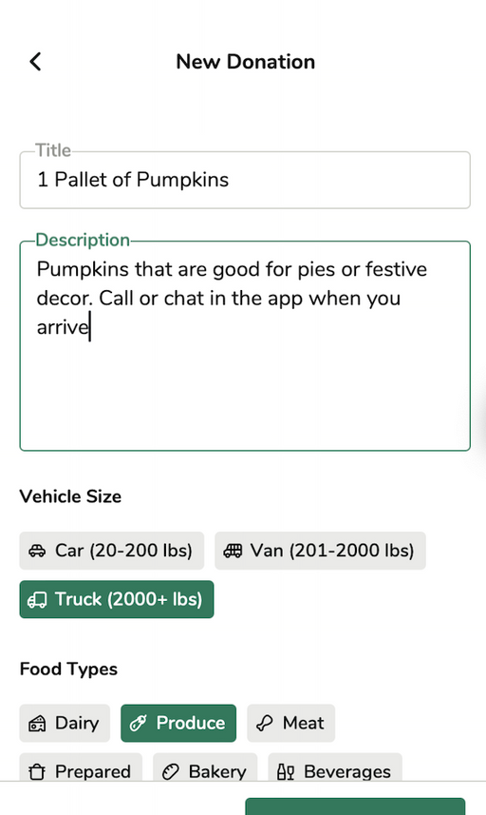
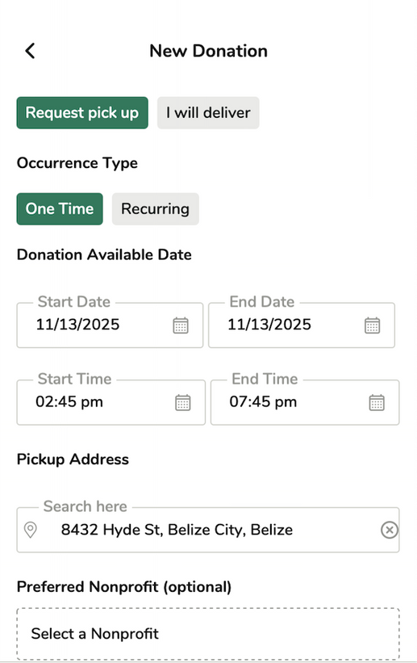
Donate
Record
Food Rescue Compliance App
Careit serves as a digital solution that:
Matches food donations from business directly to nearby nonprofit organizations.
Records all donation activities for compliance purposes.
Partner Management:
Chose partnerships by directly selecting which nonprofit organizations receive donations.

Slide 3


How does this help SB 1383?
California Schools are Required to Donate and Track
Two challenges securing partners:
Food donated is in too small of quantities
Types of food are unwanted to serve certain types of nonprofit clients
Reducing Short-Lived
Climate Pollutants
in California
1 in 5
Californians are
Food insecure

Slide 4



Careit offers a one-stop solution for SB 1383 compliance
Post Food
Donations
View Auto-Generated Contracts
View Maintained
Records
Post donations to local nonprofit network
Or assign donations to previously contacted partner
Record staff take-home meals
Careit automatically generates downloadable agreements between your organization and nonprofit partners who claim your donations
Careit stores:
Name and address of each partner
Food types donated
Donation frequency
Quantity in lbs
Notes:
Photo from Unsplash (unlicensed)

Slide 5



BILL EMERSON GOOD SAMARITAN FOOD DONATION ACT
Liability
Protection
The Act covers donations by school food authorities and institutions of higher education. These entities are expressly included in the definition of “qualified direct donors” in the Emergency Food Assistance Act of 1983, as amended by the 2018 Farm Bill.
FOOD DONATION IMPROVEMENT ACT
Expand liability protections to include not only donations made via a nonprofit intermediary, but also donations made by school food authority and institution of higher education that donate food directly to individuals.
For more information and resources visit
https://www.usda.gov/sites/default/files/documents/usda-good-samaritan-faqs.pdf

Slide 6
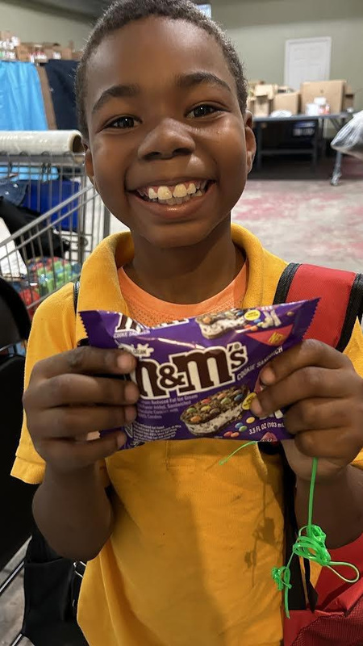
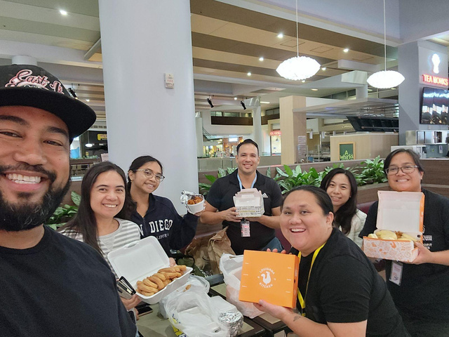

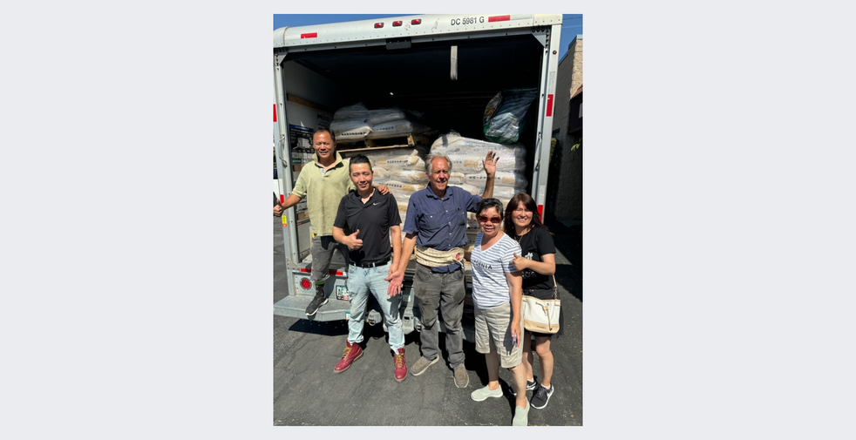
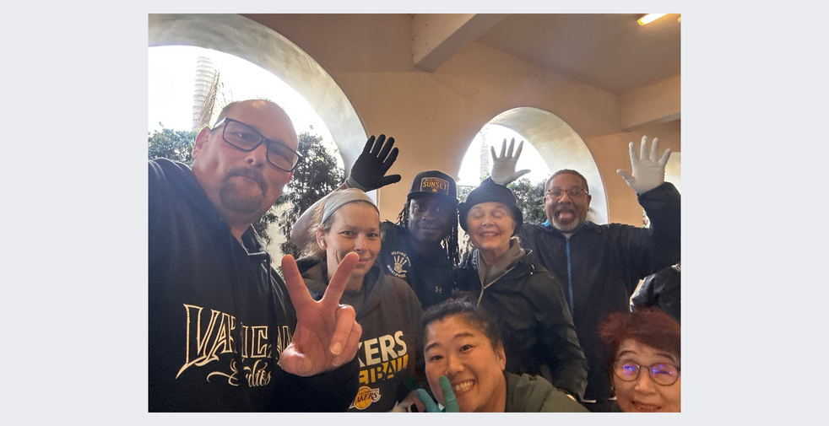
Nonprofit Partnership Collaboration
Careit collaborates with local 501(c)(3) Nonprofits such as
Soup kitchens
Shelters
Food pantries
Elderly housing complexes
Families in need
And many more community support initiatives
Direct users
Individuals and families or students experiencing food insecurity sign up
Food is claimed on a first-come first-served basis
Why work with a nonprofit?
Program oversight and recruitment
Secured liability protection
Tax deductible donations
Gateway to other services
Notes:
Photo from Unsplash (unlicensed)

Slide 7
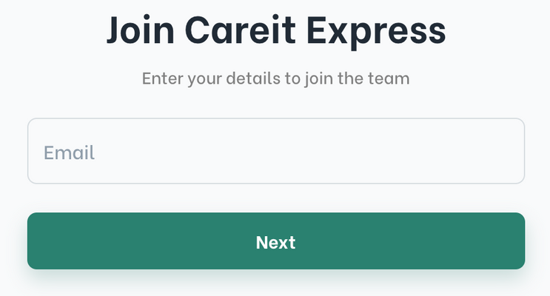
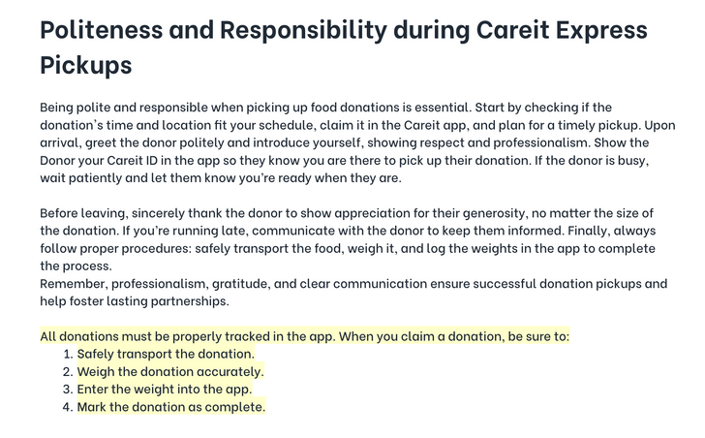
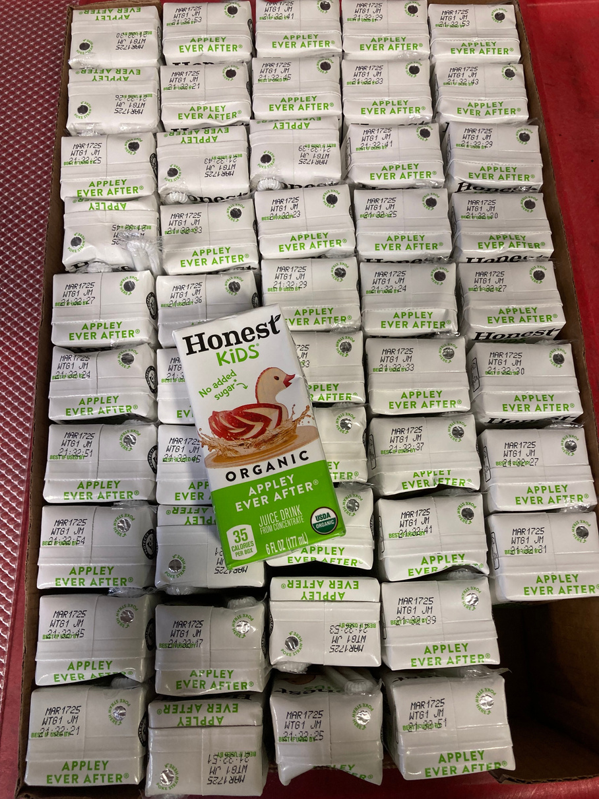
Onboarding
Signup Link
Each nonprofit has a unique user signup link that can be embedded in website
Training
Users must read safety and program expectations training and pass an exam to start reserving donations
Signup by direct invite
Or individuals can be invited directly with a name, email, and phone number
Customization
The training information and exam can be customized for each nonprofit. Users can also be required to sign a waiver to begin rescuing food

Slide 8

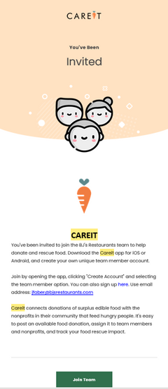
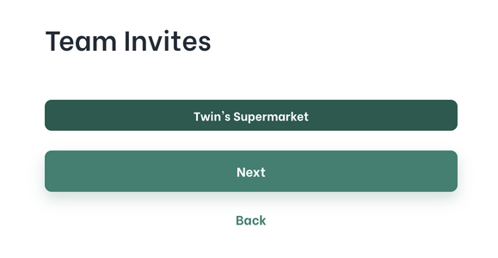
User Sign-up
1
Careit sends an account invitation email to a new user’s email address
If you can’t find the email,
just visit my.careit.com and
click Get Started
then Team Member
You’ve Been
Invited!
Join Team
Join Team
2
Select Location Name
and select Next.
If there are no pending invites, your account may have already been created and you’ll need to reset your password
You have been invited
to join an organization’s account
‹#›
Notes:
‹#›

Slide 9


How to Reset Your Password
1
Visit: my.careitapp.com/auth/reset-password
or navigate to the log-in screen
2
Click or select Forgot Password
3
Type your email address & press Reset Password
If someone previously created an account using your email address, you may need to reset your password.
4
Get the OTP (One-Time-Passcode) and enter that into the appropriate box on the password reset screen
Careit passwords must be at least 8 characters long and contain:
A
One uppercase letter
a
One lowercase letter
1
One number
!
One special character
Notes:
‹#›

Slide 10



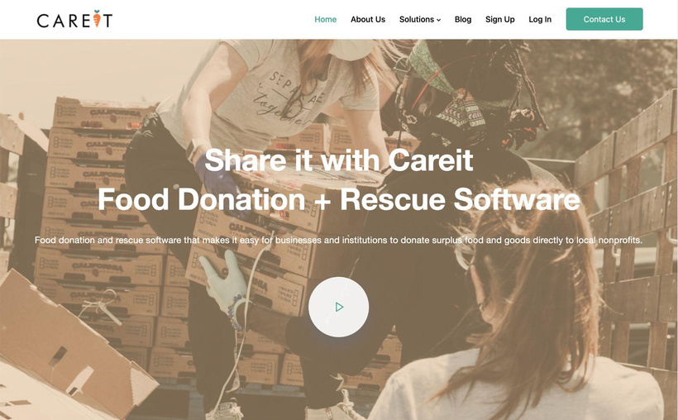
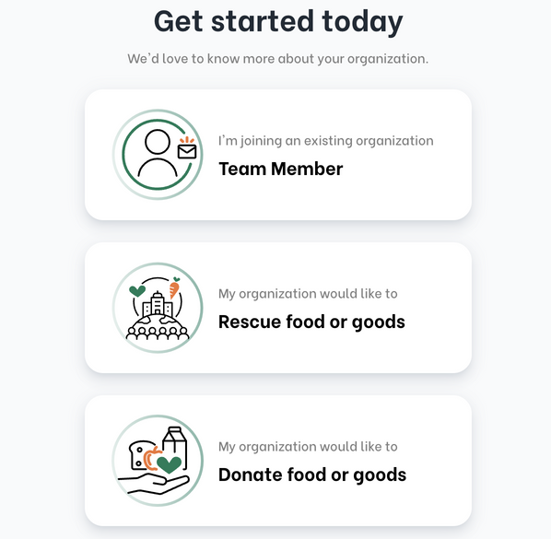
Donor/School Sign-up
1
Visit careit.com
and select Sign Up
in the top right corner
Or download the Careit App and select Create Account
Create Account
2
Select Donate food or goods and fill in the information as prompted. The first page is for information about you, the second page is for information about your business.
Contact Careit if you’re alerted a business with that address already exists.
For a school or business donor
Notes:
‹#›

Slide 11





Identify Donatable Food
Dented cans or slightly crushed or damaged boxes
Near or recently past Best/Use/Sell-By Dates
Can Donate
All edible food, including prepared food
Essential non-food household supplies
Notes:
‹#›

Slide 12






Identify Donatable Food
Spoiled or contaminated food
Food stored outside a safe temperature range
Bulging cans or unsealed bags
Can Not Donate
Potentially Hazardous Food/Temperature Control for Safety (PHF/TCS) and has been prepped or opened (i.e., liquid eggs) for more than 7 days
PHF/TCS food not cooled to 41°F within 6 hours
Notes:
‹#›

Slide 13

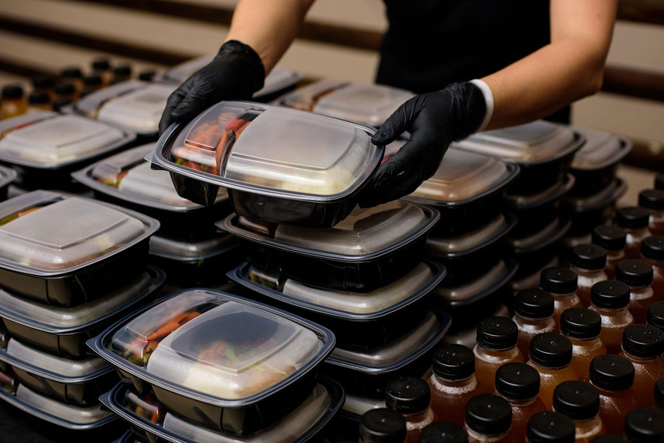
Packaging and Preparing Donations
1
Label each donation bag/container with a small description of what the food is, list any allergens, and add the prepared on date/expiration/best by date, if applicable.
For
Donation
2
Do not directly mix different types of meats or foods in aluminum trays, quart containers, or plastic bags. For instance, rice must be packaged separately from steamed carrots.
Chicken Alfredo
Contains:
Dairy, Nuts, Allium
Prepped: 01/02/26
3
Keep uncooked meats in separate containers.
4
PHF/TCS food must cool to 70°F within 2 hours and then to 41°F within 4 hours.
Notes:
‹#›

Slide 14
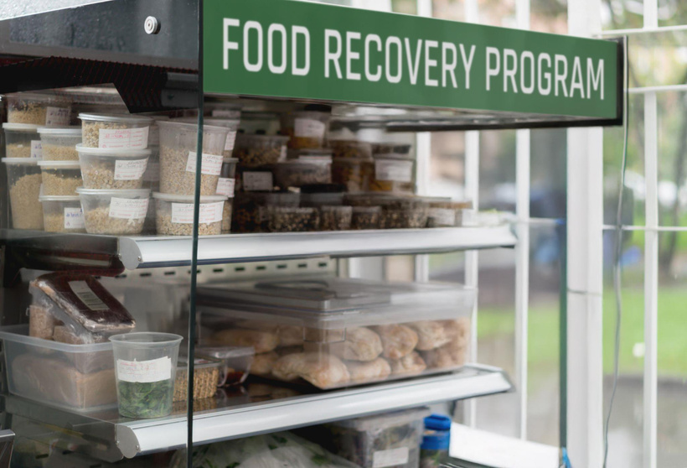

Storing Donations
Refrigeration
Dedicated Space
Store prepared food in a refrigerator if it will be picked up within 2 days. For longer storage, freeze the food.
Clearly label a specific area in the shelves, walk-in cooler, or freezer for donation items.
FRIDGE GRANTS
Grades of Green
https://gradesofgreen.org
No Kid Hungry
https://www.nokidhungry.org
Roots and Shoots
https://rootsandshoots.org
Freezer Storage
Temperature Control
Place all Potentially Hazardous Foods (PHF) or Time/Temperature Control for Safety (TCS) foods in the freezer. Exceptions include: eggs, dairy products, fried foods, and produce.
Ensure donations remain at the correct temperature until the donation driver arrives.
This means:
Refrigerated items at 41°F (5°C) or below.
Frozen items at 0°F (-18°C) or below.
Notes:
‹#›

Slide 15
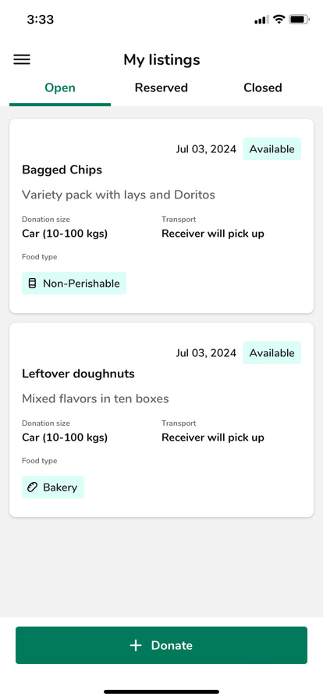
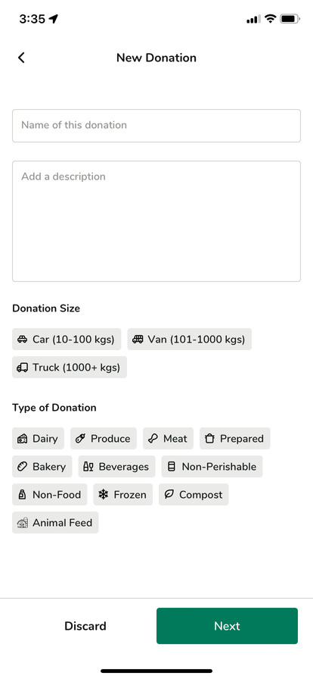
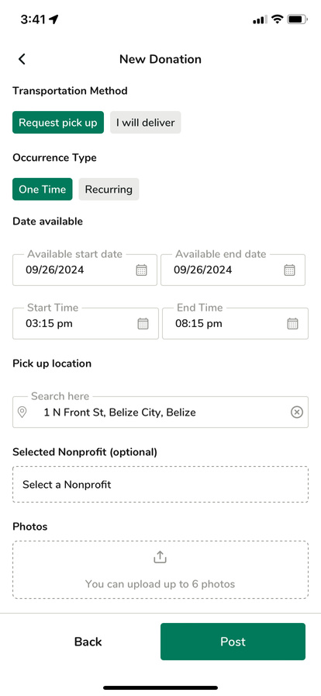

Posting a Donation
1
2
3
In the Careit app, select Donate
Fill in the form fields.
Use an appetizing title!
Finalize your
donation details
Transportation Method:
Request pick up or offer to Self-deliver if you can
Occurrence Type:
One Time or upgrade for recurring
Date Available:
Post next day dates or give
at least a 5 hour window
Notes:
Photo from Unsplash (unlicensed)

Slide 16

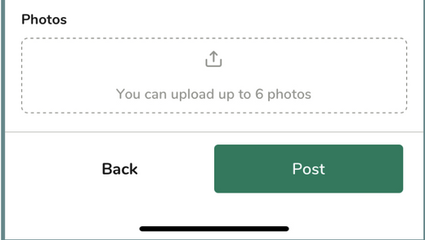



Posting a Donation (continued)
4
5
Location & Nonprofit
Upload a photo
and post!
Pickup Location:
Your account address is pre-filled.
OPTIONAL - Non-profit Assignment:
Do not choose a nonprofit unless they have already agreed to reserve your food donation on Careit.
Before Posting:
Please upload a photo of the actual food you are donating.
Select an image that clearly displays the food itself, rather than just its packaging
Notes:
Photo from Unsplash (unlicensed)

Slide 17
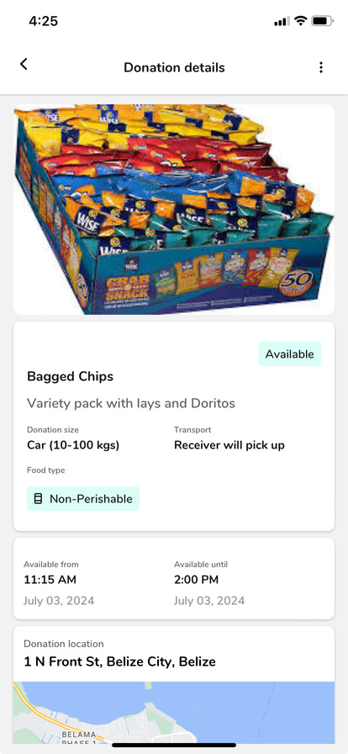
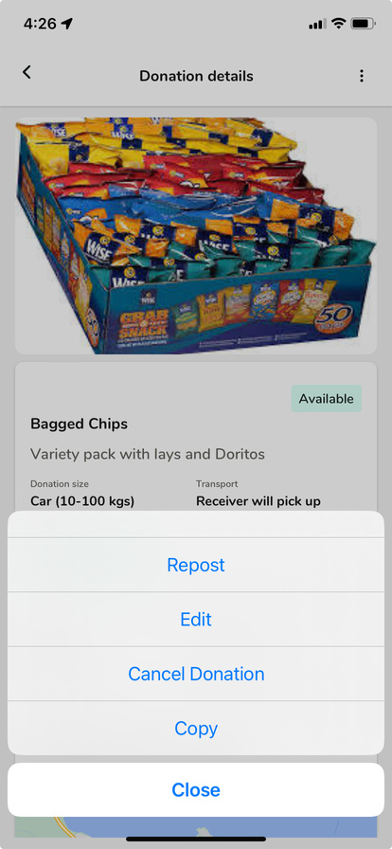

Editing a Donation
Repost:
If a nonprofit doesn’t respond after reserving your donation, use the Repost option to make it available again.
Edit:
You can update your posted donation if you need to change the pickup time or items.
Cancel Donation:
Selecting Cancel Donation will completely remove your donation from Careit.
Copy:
Use the Copy feature if you want to quickly create a new donation using details from a previous one as a template.
Notes:
Photo from Unsplash (unlicensed)

Slide 18
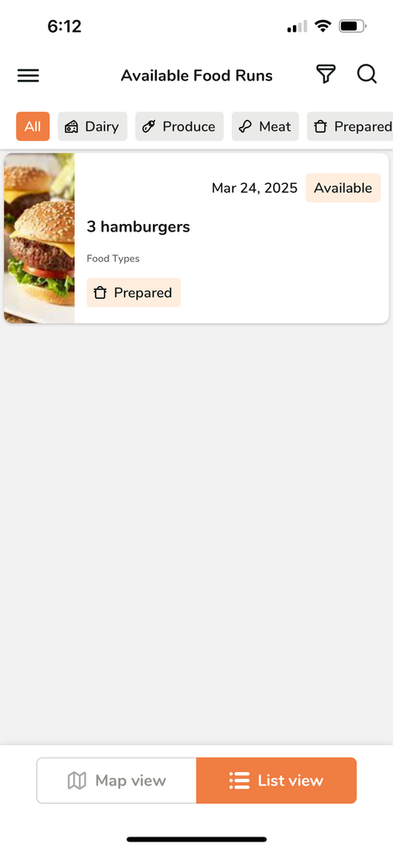
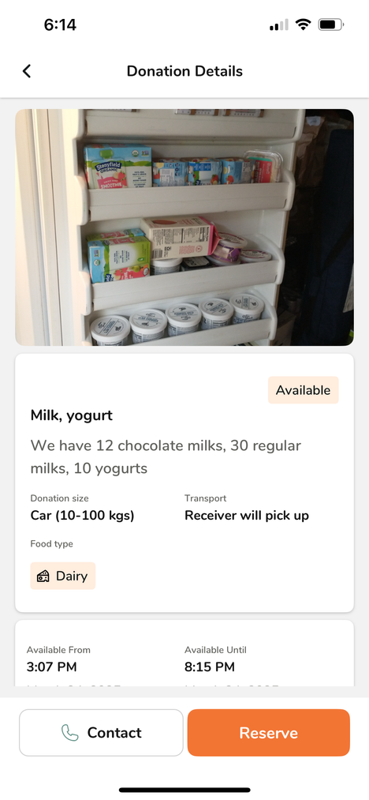
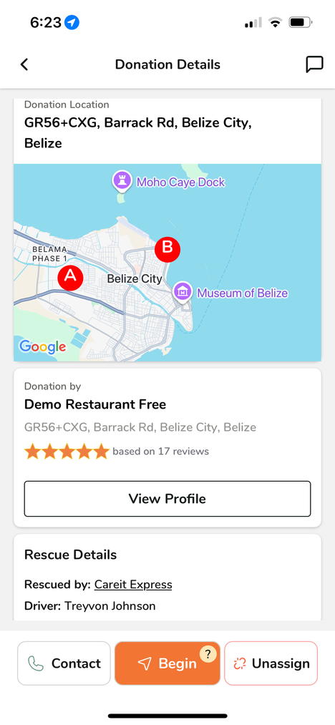
Accepting a Donation
1
2
3
In the Careit app, select Find Donations
Check details.
Only reserve donations you can rescue!
Click BEGIN. Navigate to the pickup location.
Notes:
Photo from Unsplash (unlicensed)

Slide 19
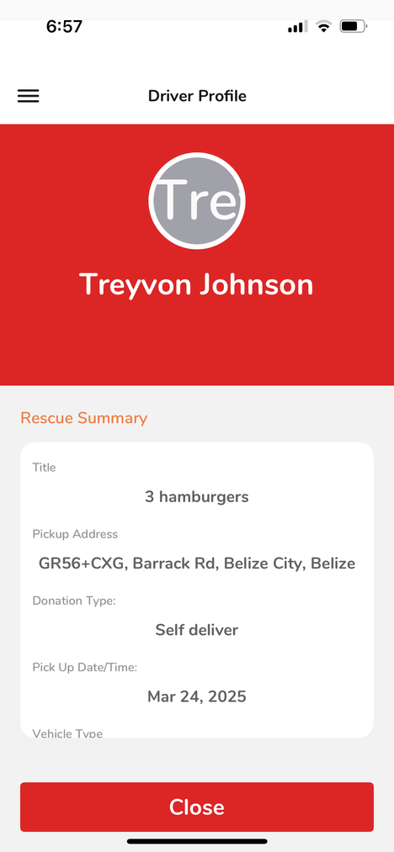
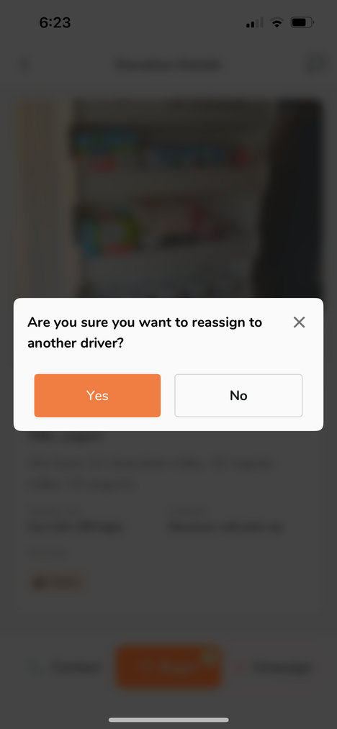
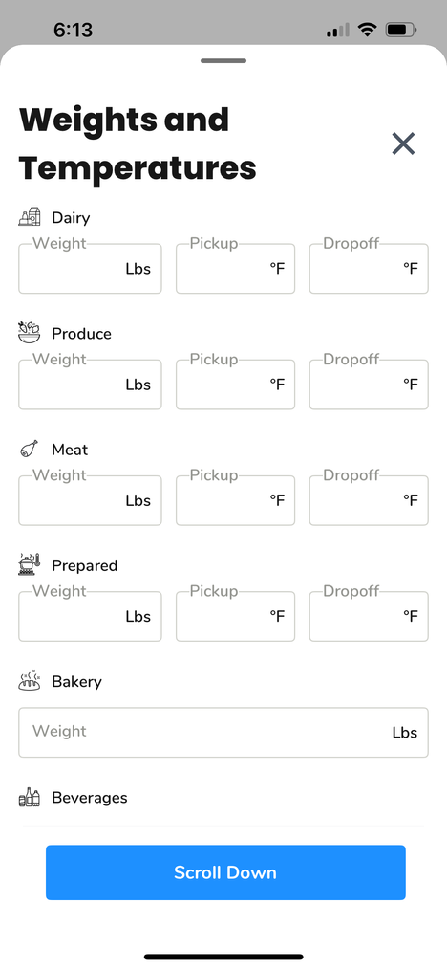
Accepting a Donation
4
5
6
Show the in-app ID Badge to the donor
Plans change? Cancel reservations to open them for another recipient
Complete your rescue and add weights
Add weights or meal numbers
Weights can be guessed, or instead of lbs, you can record a donation by meals
Temperature Check
On prepared, dairy, or meat, record the pickup and dropoff temperatures
Add notes or photos
Optional: add thank you notes or final photos for your donor
Notes:
Photo from Unsplash (unlicensed)

Slide 20
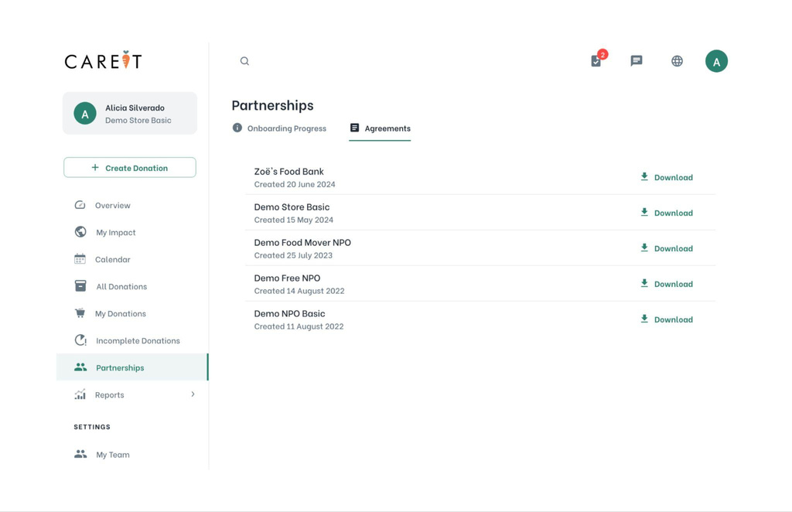
Inspections
Handling
SB 1383 Inspections
An inspector may visit to check on your SB 1383 compliance.
When this occurs, here’s your action plan.
1
Open a web browser and go to my.careit.com
Log-in with the same credentials
as you do for the mobile app.
Navigate to the Partnerships menu.
Select the Agreements tab.
5
Download your agreements here to show to inspectors.
Go to All Donations.
Use the date entry fields at the top to set the time frame for your donation history that the inspector wants to review.
Agreements are exclusively viewed on the Careit web platform, not on the mobile app.
2
6
7
3
4
Notes:
‹#›

Slide 21
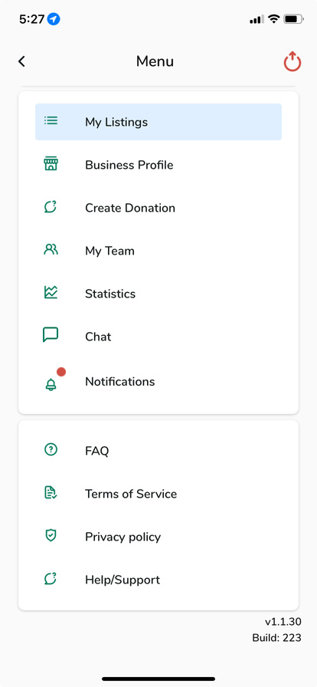
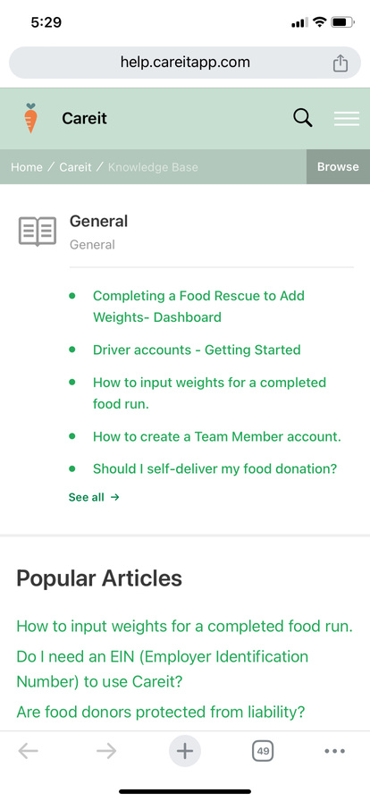
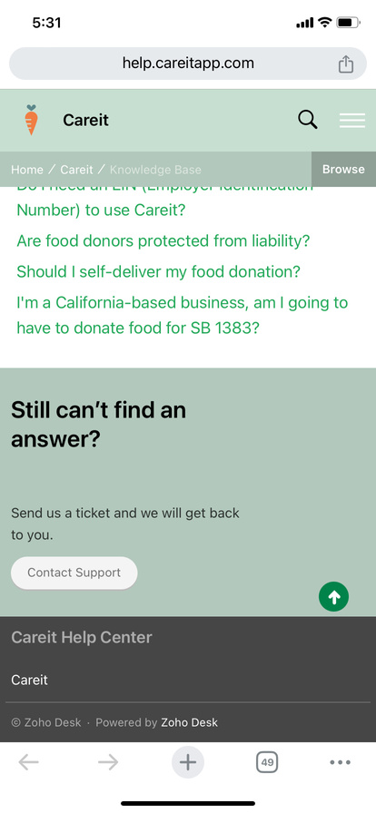
Need Help? Contact Us!
1
2
3
From the side menu
select Help/Support.
Browse general questions & how-to articles
Submit a ticket if you can’t find the answer you’re looking for.
Live Support is available Monday to Friday from 9AM to 5PM, Pacific Standard Time
Notes:
Photo from Unsplash (unlicensed)

Slide 22
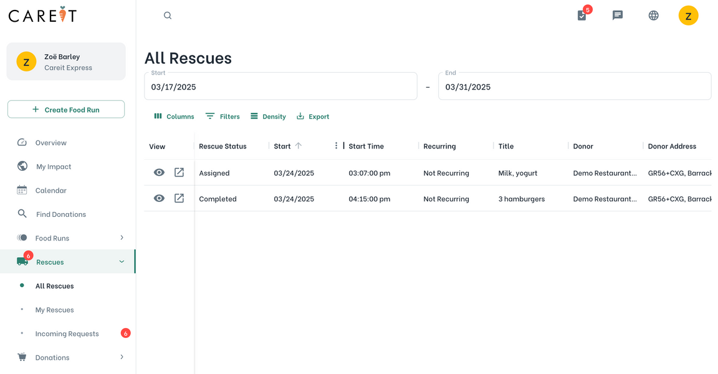
Data Privacy/Transparency
Who can see personal data?
Only the nonprofit Admin can see user names and contact from the nonprofit dashboard
Users cannot see each other in the app anywhere
Donors can see user names and phone numbers if they reserve their donation
Executive Dashboard users only see the nonprofit name
1
The nonprofit admins can view all donation data my.careit.com
Donations with missing weights can be filled out by the rescuer or the nonprofit admin
Team members who haven’t closed donations or missed pickups frequently can be removed
5
The weights of each donation will be displayed for both the nonprofit and the donor for impact tracking
Admins can post a “food run” on behalf of a donor for internal food giveaways or phone-in donations to be claimed by Careit Express users in their program
2
6
3
Notes:
‹#›

Slide 23


Getting Started
Project Setup
Resources
School Partner: Identify schools with surplus food
Reduce and Share Tables: Conduct an audit with either a student group or school staff to measure where and how much food waste is occurring
Partner Selection: Identify a nonprofit partner willing to host a Careit Express program
Gather resources: Find fridges, coolers, labeled spaces to collect and redistribute food
Create accounts and contact Careit: Once both the nonprofit and school accounts are created, reach out to Careit to activate the Careit Express account
Start recruiting: Identify families, students, and individuals who will benefit from the food donations
Training and Education: Educate students, staff, and recipient users about how to start the program
Measure, adjust, celebrate: Track data to see program success, conduct surveys, and make adjustments where needed. Most importantly, share the success of the program, no matter how small to inspire!
Food Waste Prevention Week: https://www.foodwastepreventionweek.com/k-12schools
World Wildlife Foundation: https://www.worldwildlife.org/teaching-resources/toolkits/be-a-food-waste-warrior
WA Food Share Program Toolkit: https://www.epa.gov/sustainable-management-food/washington-school-food-share-program-toolkit
Food Tray Audit Guide:
https://www.co.dakota.mn.us/Environment/School/Organics/Documents/SchoolTrayAuditGuide.pdf
TreePeople Food Waste Student Project Toolkit
https://treepeople.org/toolkits-guides/
K-12 Food rescue program toolkit
https://www.foodrescue.net/
Notes:
Print for your office wall :)
‹#›

Slide 24
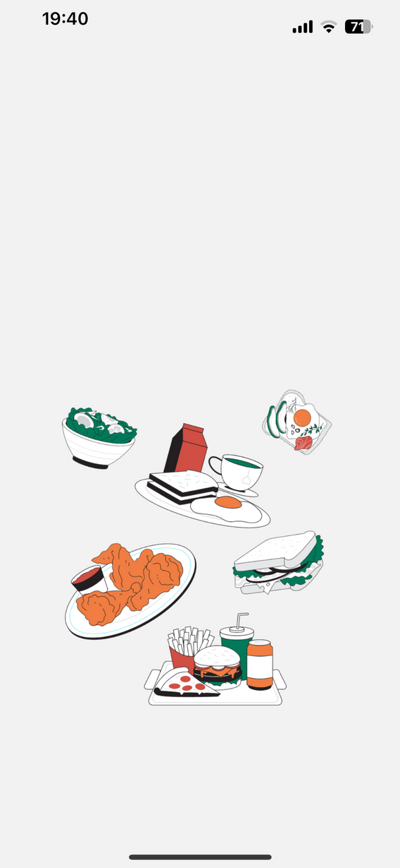
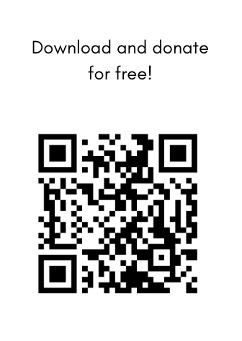


Thank
You!
Scan QR Code to Download the Careit App
Any questions?
Feel free to reach out!
1-833-366-3365
Hello@Careit.com

